Slide 1
Automatic Filter Network Generation And Extraction Tool (beta v0.1)
Yuxuan Chen

Slide 2
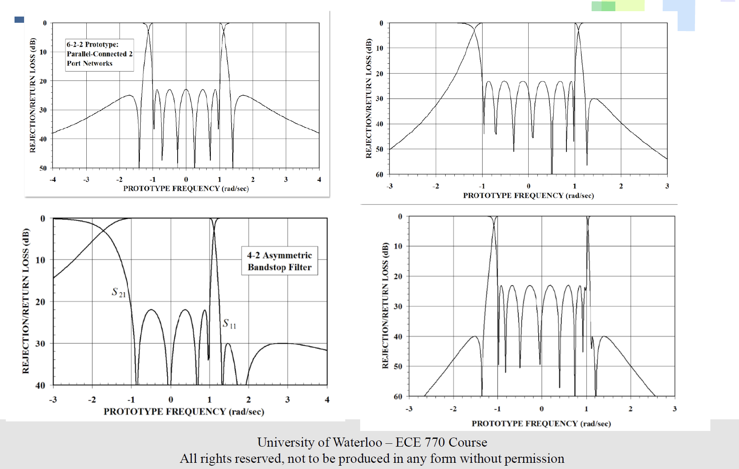
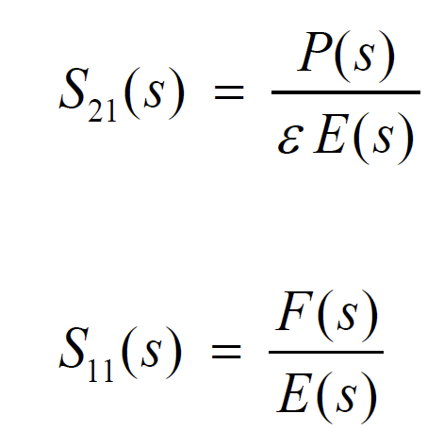
Background

Slide 3
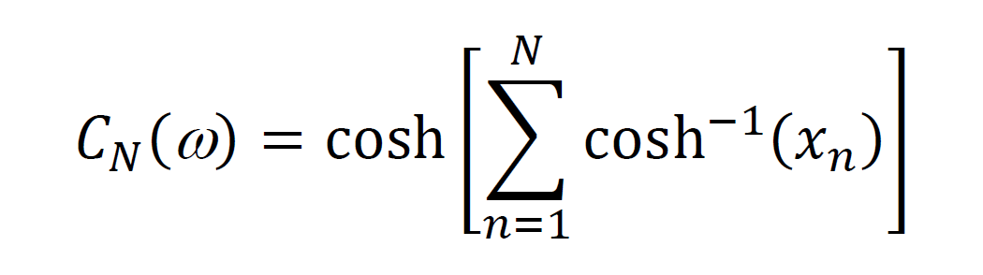
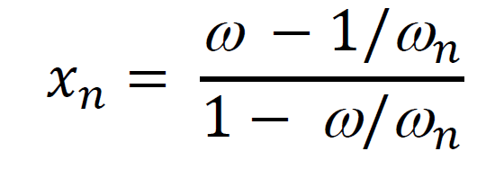
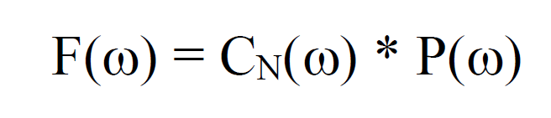
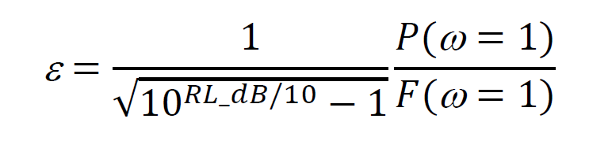
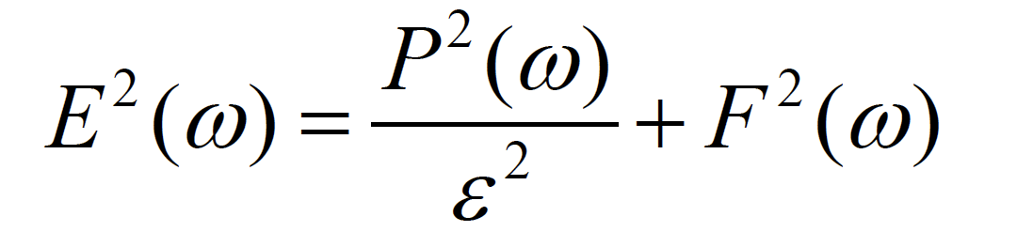
Procedure of solving filter polynomials
Get P(s) from the positions of transmission zeros.
Solve F(s) numerically or iteratively from P(s).
Solve ε and E(s) from:
Numerical:

Slide 4
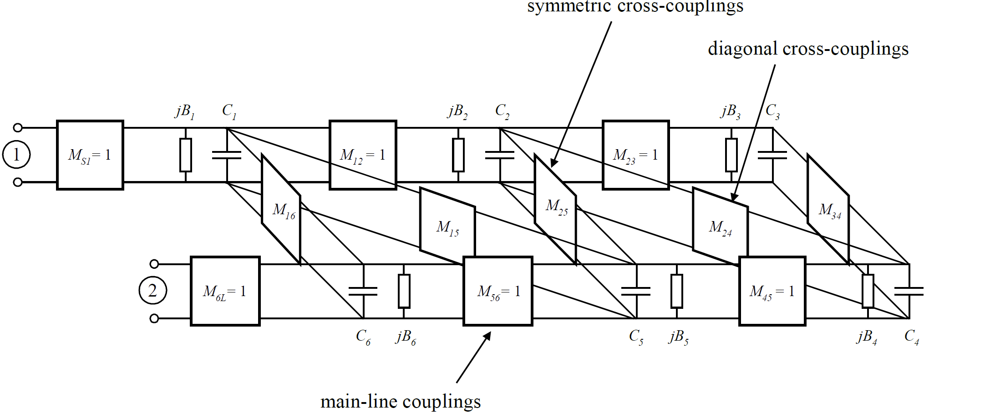
Filter Network Synthesis

Slide 5
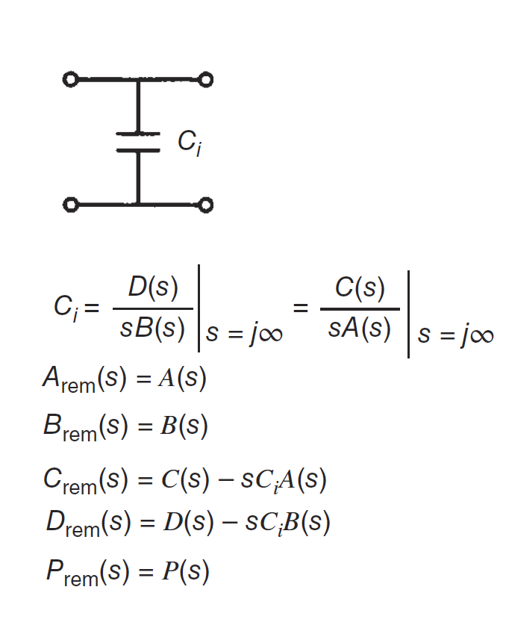
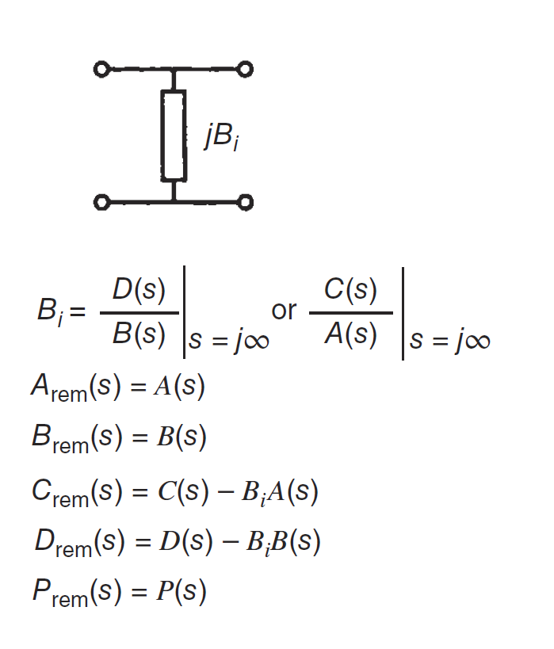
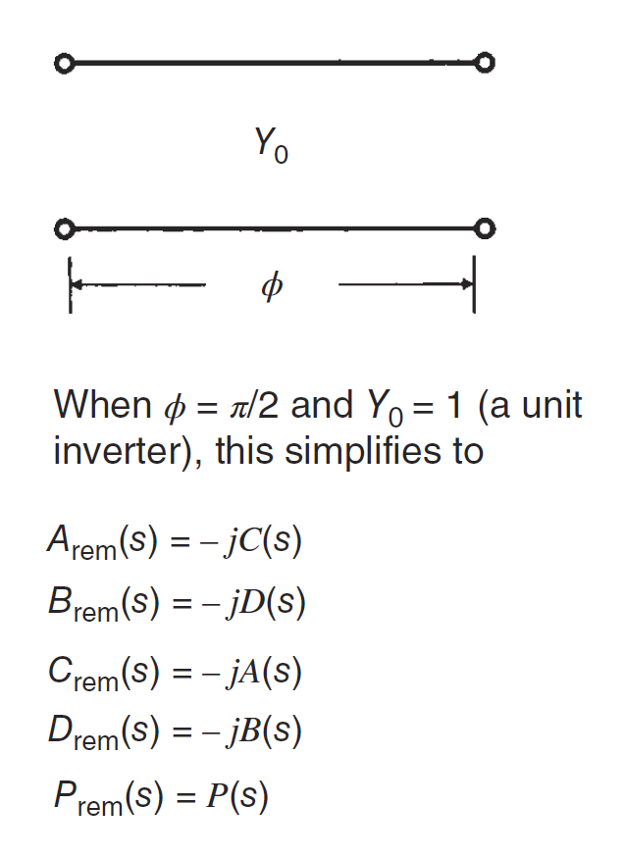
Network Extraction

Slide 6
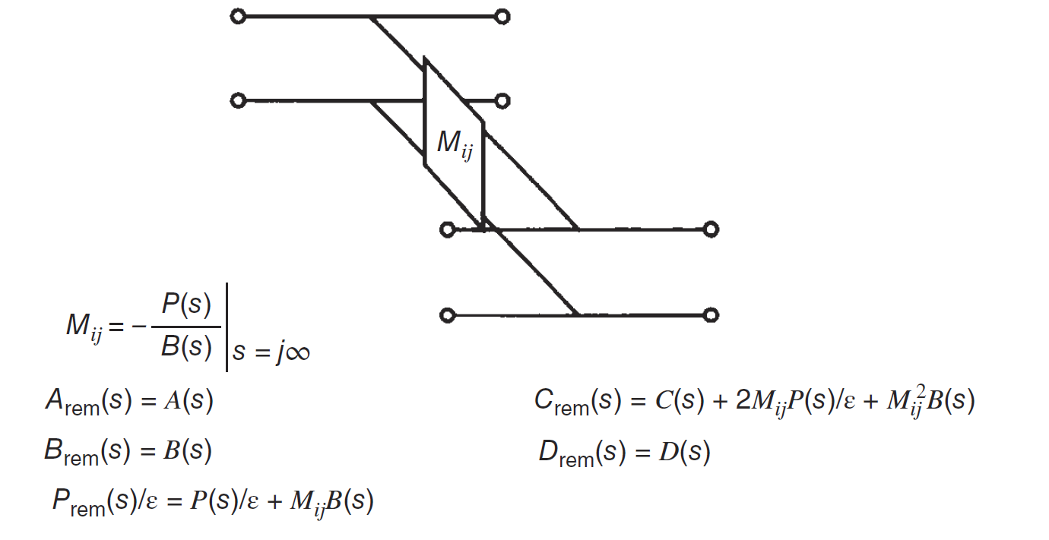
Network Extraction

Slide 7
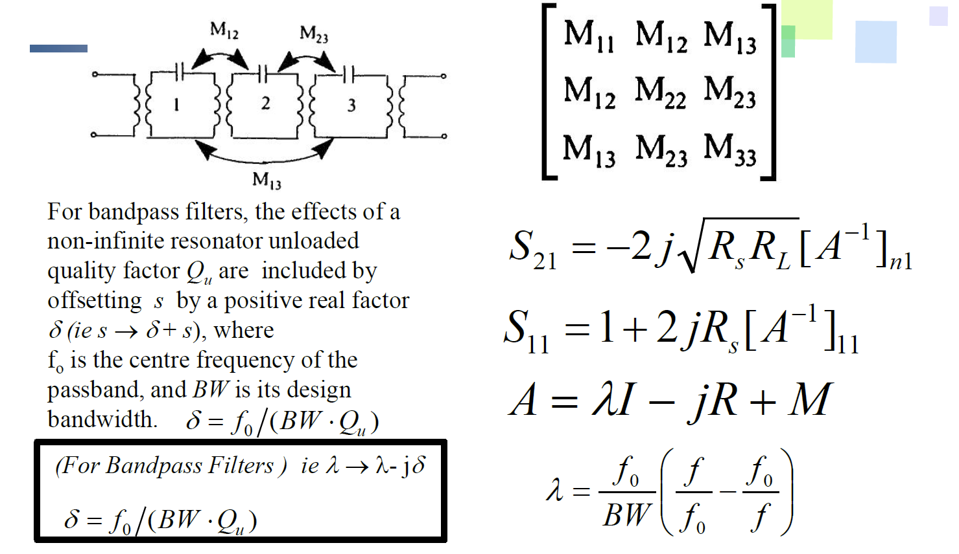
M Coupling Matrix

Slide 8
Filter Network Synthesis

Slide 9
Automatic Filter Network Generation And Extraction Tool
Fast algorithm and simple user interface
Automatically generate filter polynomials and extract network components
Work for any filter order N, RL and any positions of transmission zeros
User selectable coupling connections and FIR components in network synthesis
Multiple polynomial solvers and option for forcing end cross coupling
Network synthesis results verification
Automatically find valid network coupling connection
M matrix similarity transformation

Slide 10
Automatic Filter Network Generation And Extraction Tool
Fast algorithm and simple user interface
Automatically generate filter polynomials and extract network components
Work for any filter order N, RL and any positions of transmission zeros
User selectable coupling connections and FIR components in network synthesis
Multiple polynomial solvers and option for forcing end cross coupling
Network synthesis results verification
Automatically find valid network coupling connection
M matrix similarity transformation

Slide 11
Demo

Slide 12
Current version problems
Data structure and algorithms can be optimized
Odd filter order N is not supported
Asymmetric transmission zeros are not recommended
E(s) calculation algorithm needs to be more robust

Slide 13
Thank you

